Slide 1
Amicable Contempt Final dissertation proposal
Andrew Heiss
Sanford School of Public Policy
andrew.heiss@duke.edu

Slide 2
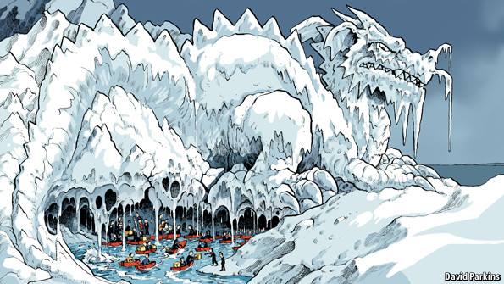
INGOs in Authoritarian Regimes
Dictators and INGOs | Questions | Theory | Data | The future
Notes:
http://www.economist.com/news/china/21600747-spite-political-clampdown-flourishing-civil-society-taking-hold-beneath-glacier
Only NGOs that dealt with the poor, elderly, disabled

Slide 3
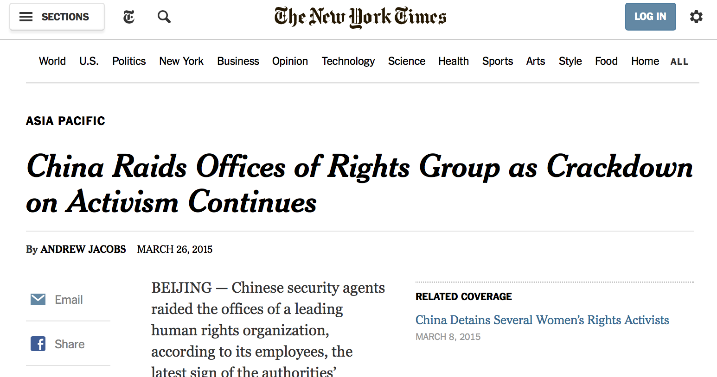
INGOs in Authoritarian Regimes
Dictators and INGOs | Questions | Theory | Data | The future
Notes:
Activists + INGOs working with disabled people

Slide 4
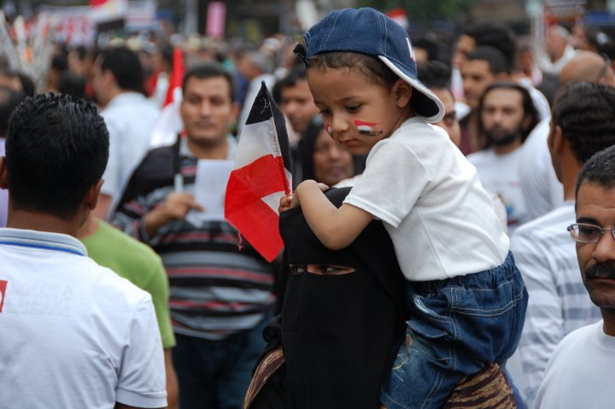
INGOs in Authoritarian Regimes
Dictators and INGOs | Questions | Theory | Data | The future
Notes:
http://www.icnl.org/news/2014/25-July.html

Slide 5

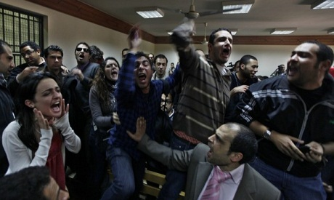
INGOs in Authoritarian Regimes
Dictators and INGOs | Questions | Theory | Data | The future
Notes:
http://foreignpolicy.com/2013/06/05/egypts-ngos-matter/
http://english.ahram.org.eg/NewsContent/1/64/54687/Egypt/Politics-/Draft-law-Foreign-NGOs-and-funding-still-require-p.aspx

Slide 6

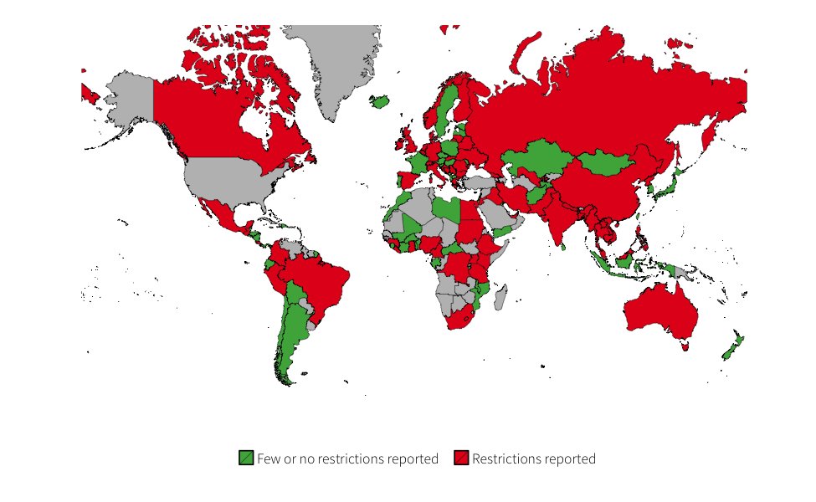
Pawns of a dictator?
Dictators and INGOs | Questions | Theory | Data | The future

Slide 7
Big questions
How and why do dictators manage INGOs?
How do INGOs respond to that regulatory environment?
Dictators and INGOs | Questions | Theory | Data | The future

Slide 8
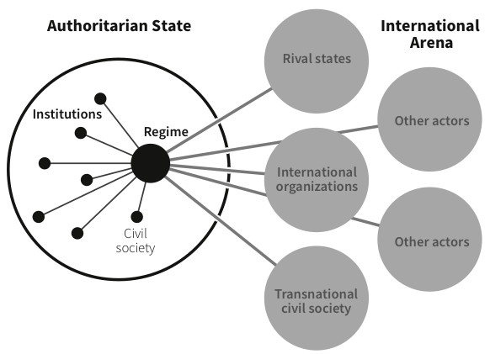
How and why do dictators manage INGOs?
Dictators and INGOs | Questions | Theory | Data | The future

Slide 9
How do INGOs respond to that regulatory environment?
Be as principled as possible within regulatory constraints
Dictators and INGOs | Questions | Theory | Data | The future

Slide 10
Negotiations, ZOPAs, and INGO Regulations
http://ingorestrictions.org/theory.html
Dictators and INGOs | Questions | Theory | Data | The future

Slide 11
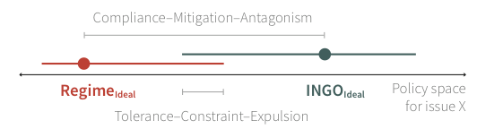
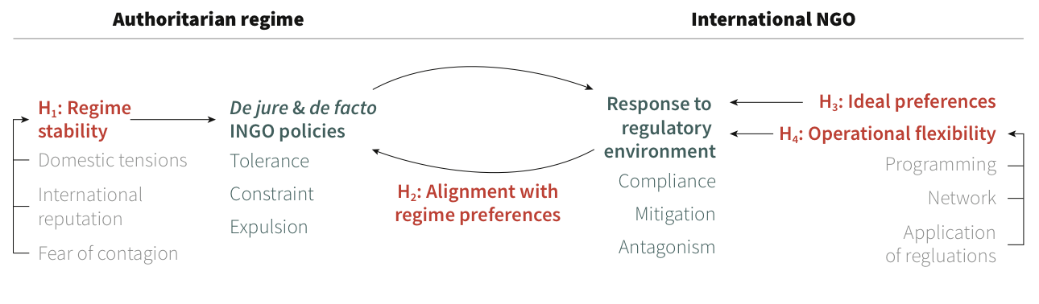
Theory and hypotheses
Dictators and INGOs | Questions | Theory | Data | The future

Slide 12
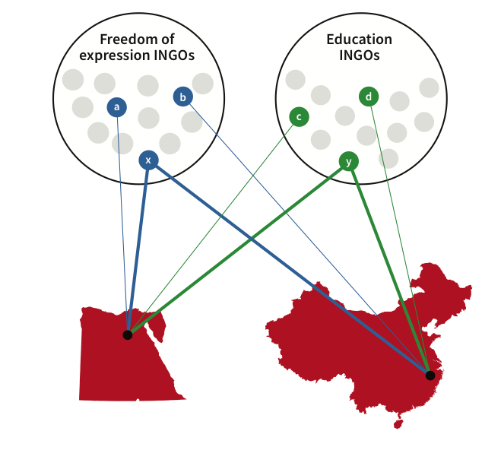
Integrative multi-method research
Cross national time series data
Network data
Media archives
Interviews
Surveys
Dictators and INGOs | Questions | Theory | Data | The future

Slide 13
Example NGOs
Education
Freedom of Expression
World Education
Article19
International Media Support
Global Campaign for Education
Free Press Unlimited
SIL International
Committee to Protect Journalists
CARE International
Dictators and INGOs | Questions | Theory | Data | The future

Slide 14
Questions I still have
External validity
Sample selection and causality
Measurement
Is this doable from a distance?
Dictators and INGOs | Questions | Theory | Data | The future
Notes:
Is this stuff generalizable to other normal dictatorships?
Just looking at the findable organizations + the ones I can contact and research imposes some threats to the validity – this isn’t an experiment, just observational data

